Slide 1

Insights
Data set contains 73 order and 9 restaurants. Most of orders were done by using promocode. Very less organic growth which is a weakness. Whereas only one order got cancelled which might be good of service and food quality.

Slide 2
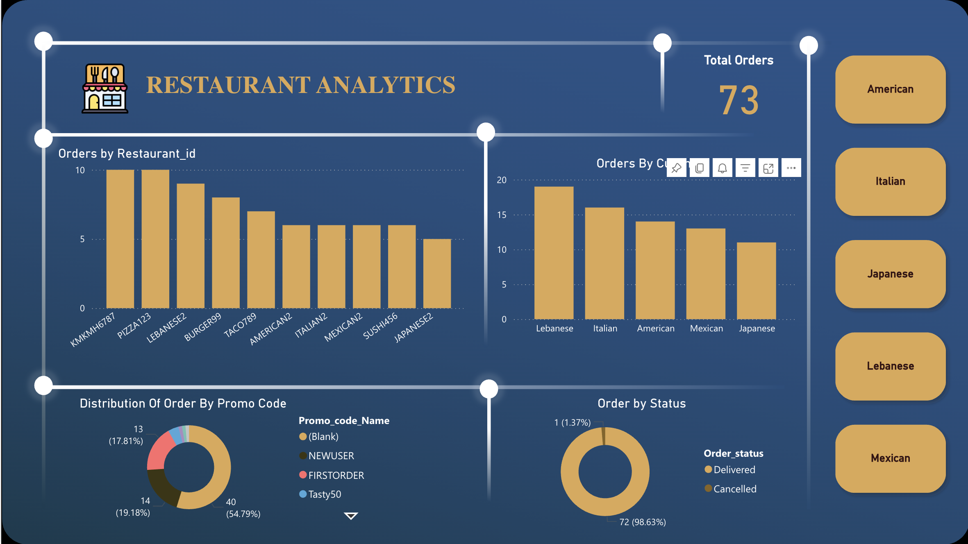

Slide 3

Find top 3 outlets by cuisine type without limit and top function
Restaurant_id | Cuisine | count | rn
AMERICAN2 | American | 6 | 1
BURGER99 | American | 8 | 2
ITALIAN2 | Italian | 6 | 1
PIZZA123 | Italian | 10 | 2
JAPANESE2 | Japanese | 5 | 1
SUSHI456 | Japanese | 6 | 2
LEBANESE2 | Lebanese | 9 | 1
KMKMH6787 | Lebanese | 10 | 2
MEXICAN2 | Mexican | 6 | 1
TACO789 | Mexican | 7 | 2

Slide 4
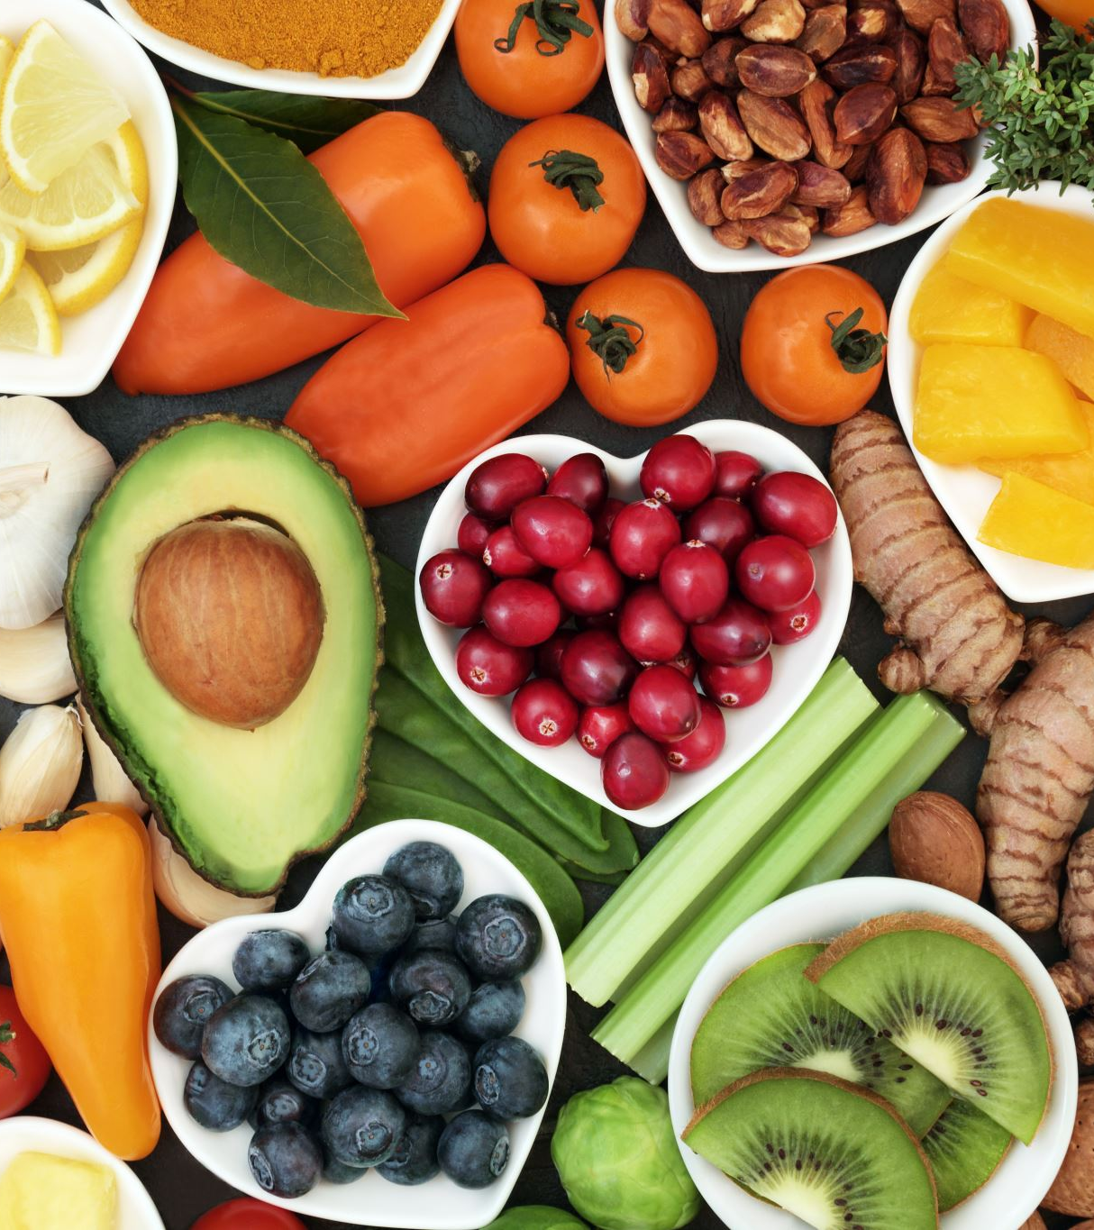
Find the daily new customer count from launch date (Every day how many customers we are acquiring?)

Slide 5

Count all users who were acquired in Jan 2025 and only placed one order in Jan and did not place any other order

Slide 6

List all the customer with no orders in last seven days but were acquired one month ago with their order on promo

Slide 7
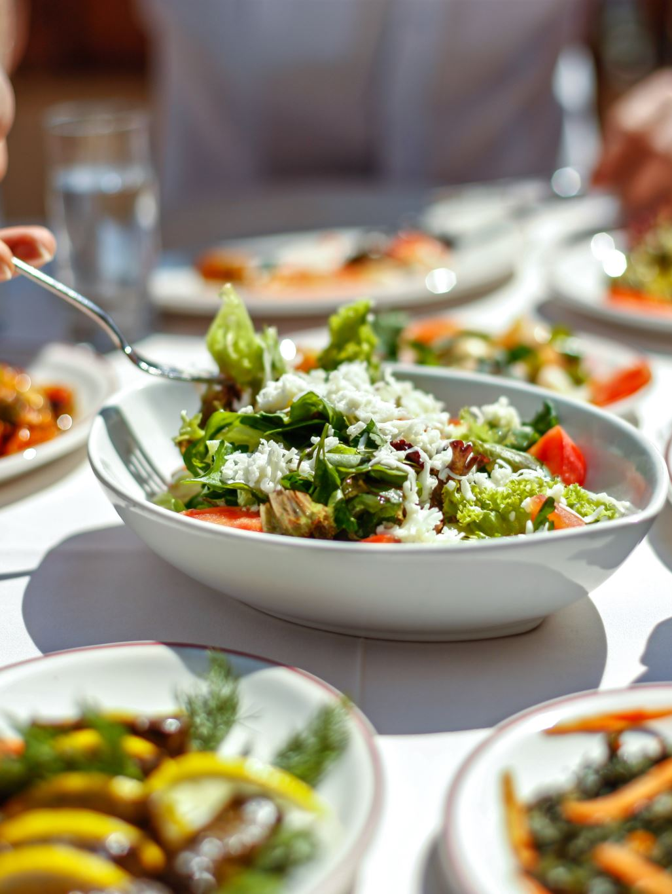
Growth team is planning to create a trigger that will target customers after their every third order with personalized communication and they have asked you to create query for this
No Record In Table

Slide 8
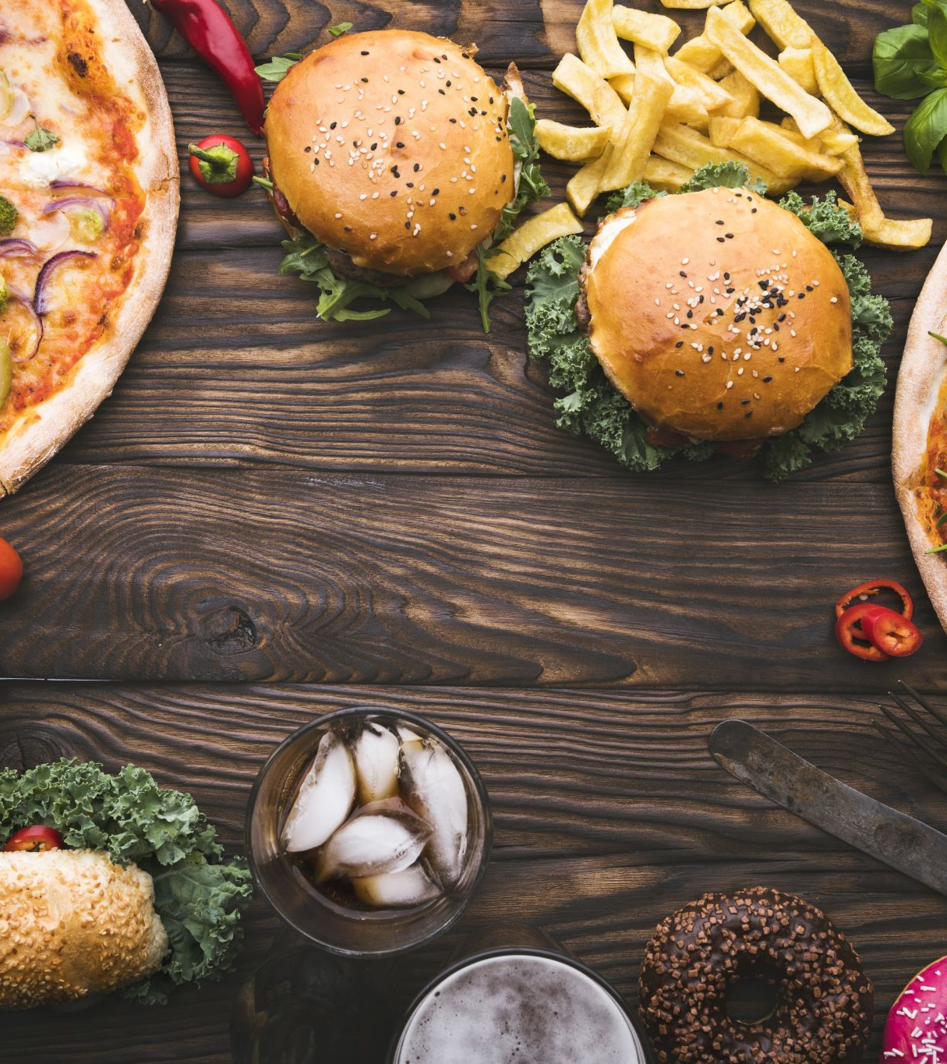
List all customer who made more than one order all orders on promo only

Slide 9
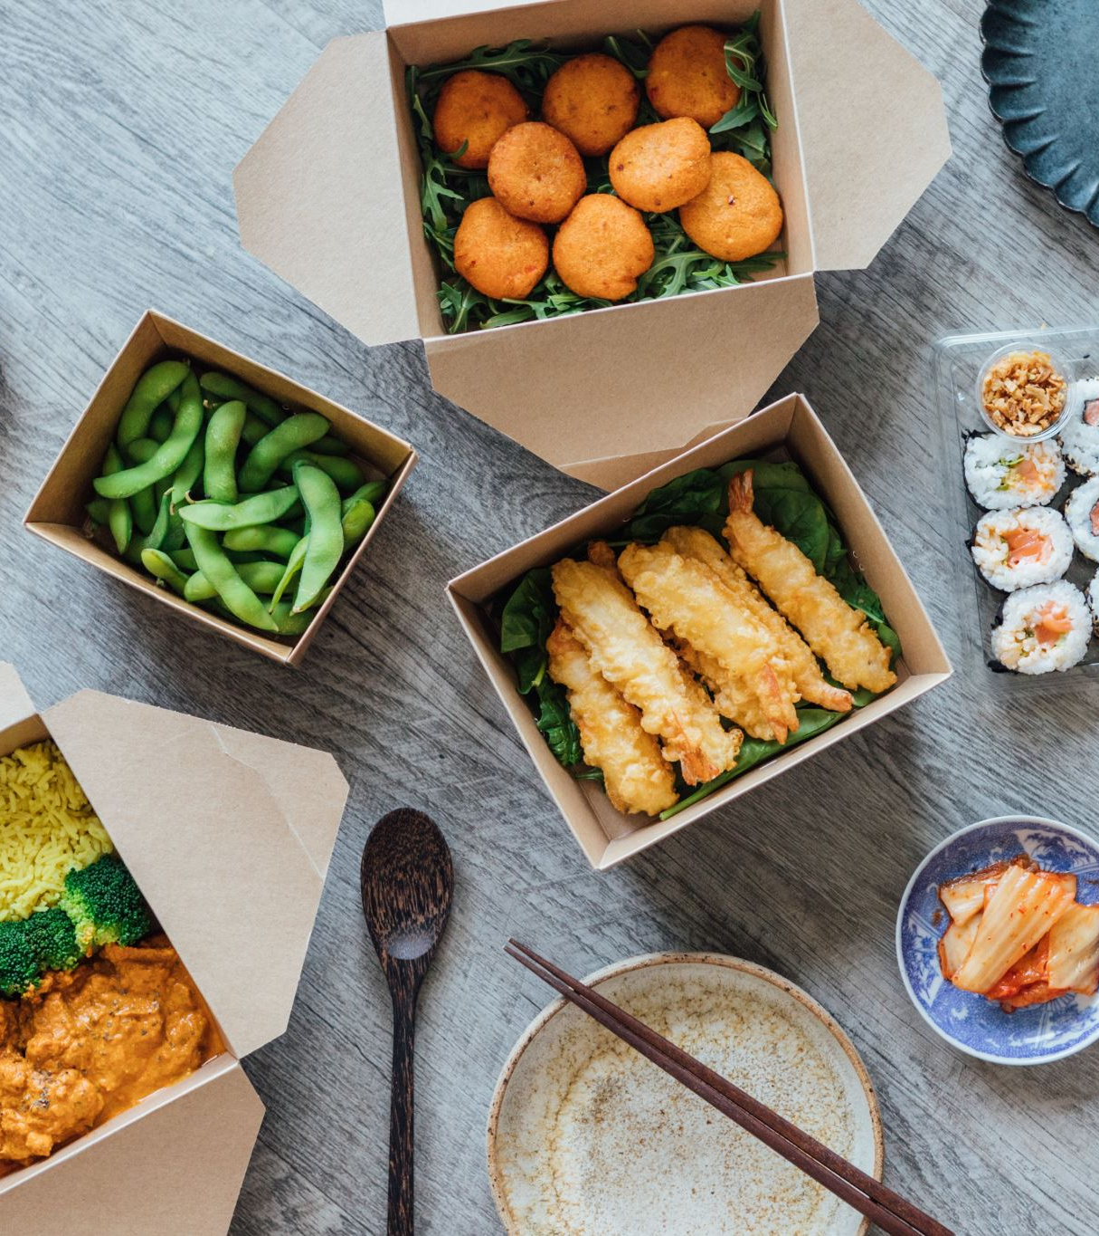
What percentage of customer where organically required in Jan 2025. (Placed their first order without any promo code)
43.90%

